Slide 1
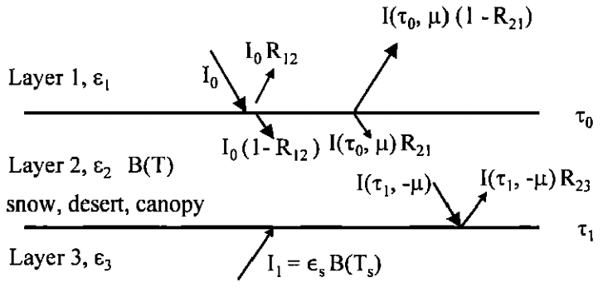
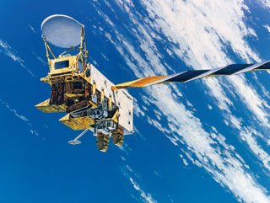
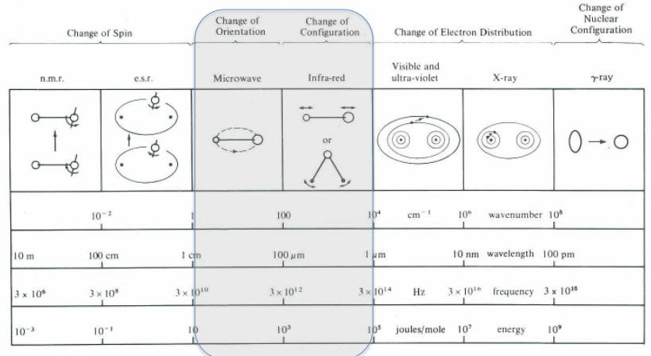
Numerical Simulation Research of the Microwave Radiation Transfer over the Complicated Land Surface Using CRTM and MWRT Models

Slide 2
During the process of passive microwave remote sensing, the microwave radiation transmits through the atmosphere and clouds and is received by the sensors on the satellite.
Different from the surface of the ocean, the land is a relatively complicated surface. The properties of the land surface will affect the microwave radiation emitted.
How will the properties, such as land vegetation cover, moisture content in the soil, surface temperature and snow depth, have effect on the radiation emitting, and what are the sensitivities of the radiation to these variables?

Slide 3
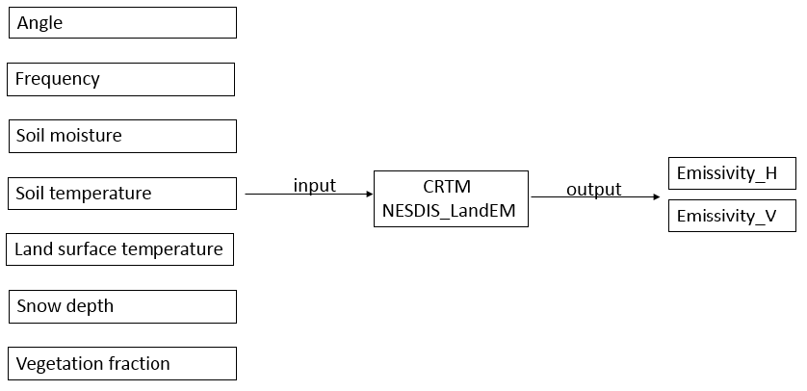
Method & Models
CRTM (Community Radiative Transfer Model) is a model of NCEP, in this study, I used the a subroutine called NESDIS_LandEM to calculate the emissivity of the land surface. The input variables of this function are frequencies, angle, soil temperature, soil moisture content, vegetation cover, snow depth. The output variables are emissivity of horizontal and vertical polarization

Slide 4
surface is divided into 3 layers
air layer
2. scattering particles layer
3. Soil layer
every layer can emit microwave radiation itself, according to the radiation reached the first layer plus the radiation reflected from the upper sky, we can calculate the emissivity of the land surface

Slide 5
MWRT (Microwave Radiation transfer) is a fast and accurate transfer model. It can simulate the transfer from ocean and land surface to the atmosphere
The discrete ordinate method (DOM) with sufficient stream number has been proven to solve radiative transfer problems
MWRT adapted the 4-stream DOM method to solve the radiative transfer

Slide 6
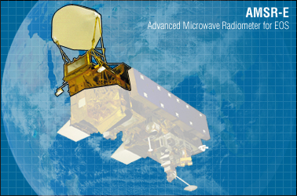
The Advanced Microwave Scanning Radiometer for EOS (AMSR-E) is a twelve-channel, six-frequency, total power passive-microwave radiometer system. It measures brightness temperatures at 6.925, 10.65, 18.7, 23.8, 36.5, and 89.0 GHz. Vertically and horizontally polarized measurements are taken at all channels.

Slide 7
goals
Understanding how the land surface properties affect the emissivity. This will provide theoretical analysis for retrieving the parameters such soil temperature, soil moisture and vegetation cover.
Understanding in the clear sky, how water vapor affect the transmission of the microwave radiation. This will provide theoretical analysis for choosing the proper channel in remote sensing.
Understanding how non-precipitation clouds affect the transmission of the radiation. This will provide theoretical analysis for eliminating the clouds and choosing a proper channel in remote sensing.
Getting global emissivity distribution data set after simulation.

Slide 8
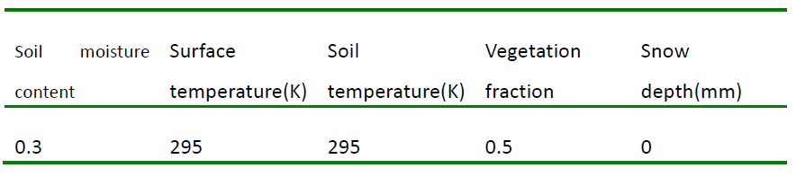
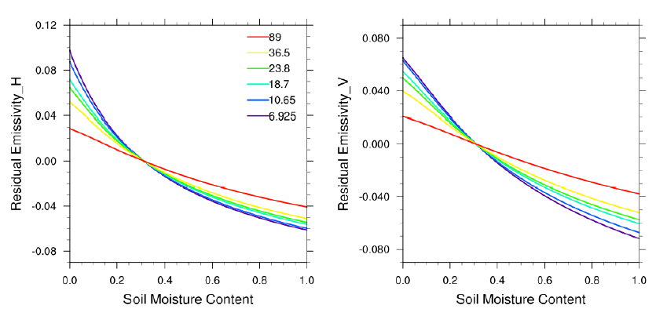
Simulation experiments (CRTM) -The response of land surface emissivity to land properties
The response of emissivity to soil moisture content:
When increasing the soil moisture, the horizontal and vertical emissivity will decrease.
The soil moisture content changes the permittivity of the soil.
The sensitivities of the emissivity in lower frequencies are bigger than that in higher frequencies.
The emissivity of horizontal polarization is more sensitive than that of vertical polarization.

Slide 9
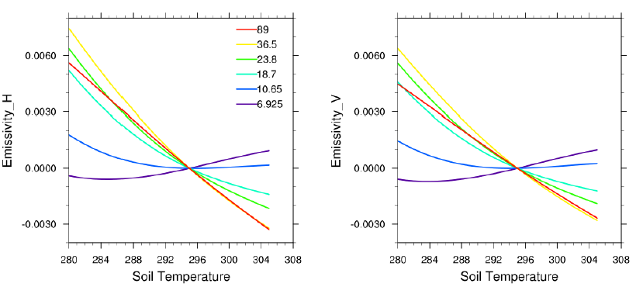
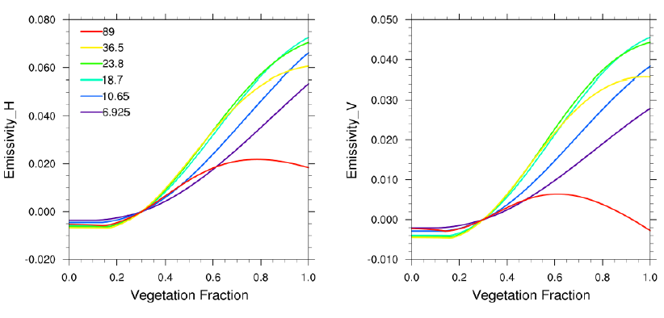
The response of emissivity to soil temperature
When the soil temperature increases, the emissivity of 89GHz, 36.5GHz, 23.8GHz and 18.7GHz decrease. The emissivity of 10.65GHZ and 6.925GHz will decrease first and then increase slightly. It is also because the soil temperature changes the permittivity of the soil.
The emissivity in 36.5GHz is most sensitive.
The response of emissivity to vegetation cover
The emissivity in 89GHz will decrease and then increase. The emissivity in other frequencies will all increase.
The increasing area of vegetation canopy will scatter the microwave radiation emitted from the soil surface, causing the decrease of the emissivity.

Slide 10
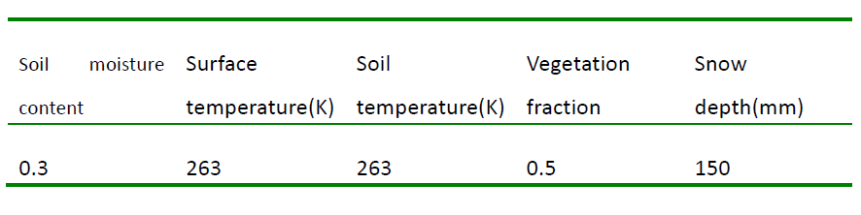
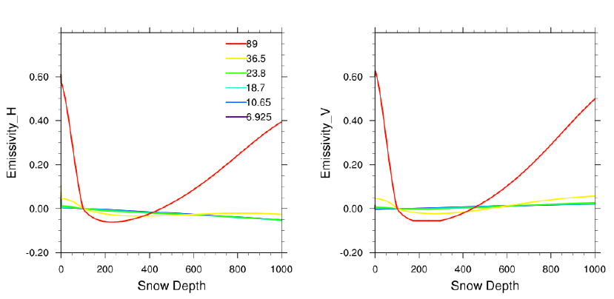
The response of emissivity to snow depth
when the snow depth increases, the emissivity in all frequencies except 89GHz and 36.5GHz will decrease. It is because the microwave radiation emitted from the surface will transmit through the snow cover and thus be deducted by the scattering of snow particles.
However, the snow depth has a great effect on the emissivity in 89GHz. When the snow is deeper than 200mm, the emissivity in 89GHz will increase as the depth increases. The reason is that when the snow depth is increasing, the emission of the radiation from snow itself will increase.

Slide 11
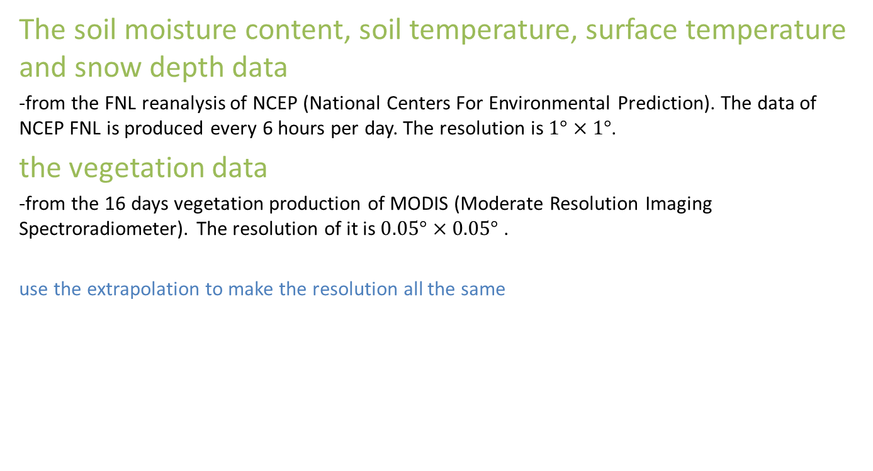
The global emissivity distribution from the simulation of CRTM
The soil moisture content, soil temperature, surface temperature and snow depth data
-from the FNL reanalysis of NCEP (National Centers For Environmental Prediction). The data of NCEP FNL is produced every 6 hours per day. The resolution is $1°×1°$.
the vegetation data
-from the 16 days vegetation production of MODIS (Moderate Resolution Imaging Spectroradiometer). The resolution of it is $0.05°×0.05°$ .
use the extrapolation to make the resolution all the same

Slide 12
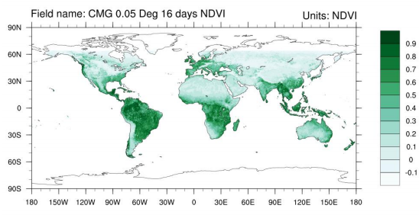
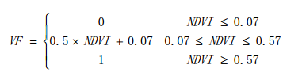
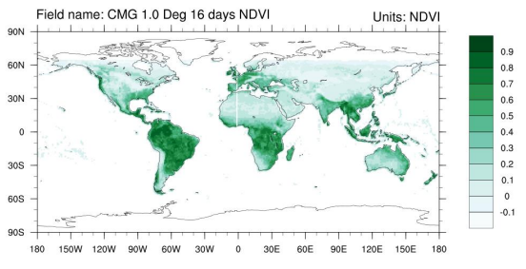
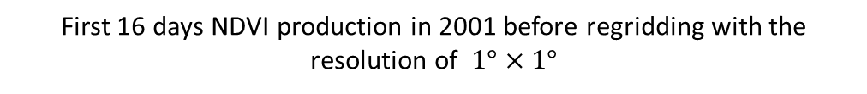
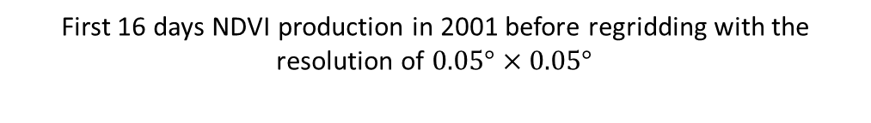
In order to calculate the vegetation coverage, we use the following equations:
First 16 days NDVI production in 2001 before regridding with the resolution of $0.05°×0.05°$
Where VF is the vegetation coverage in percentage
First 16 days NDVI production in 2001 before regridding with the resolution of $1°×1°$

Slide 13
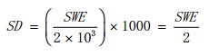
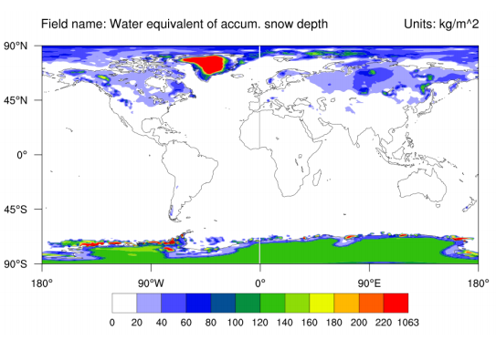
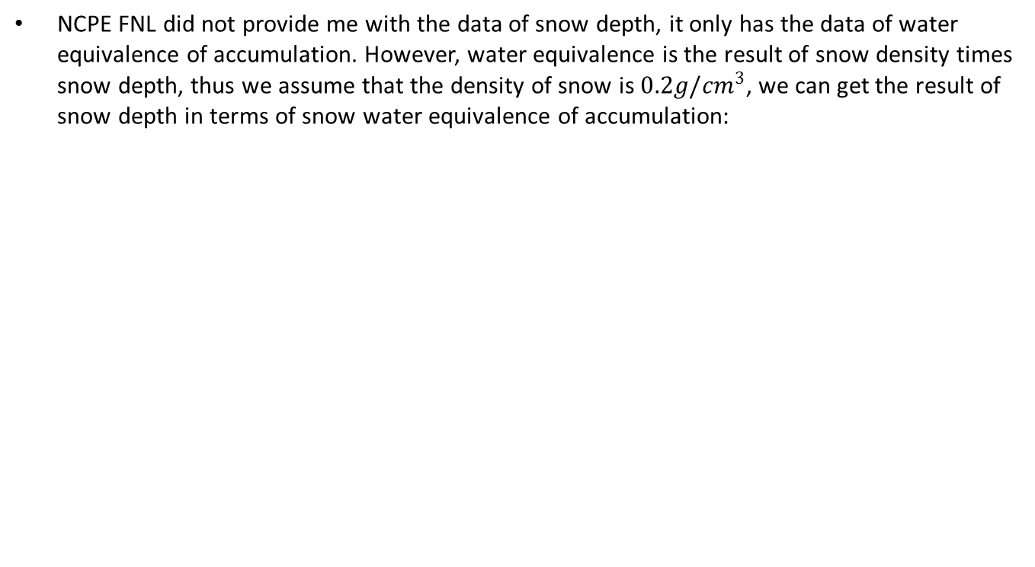
NCPE FNL did not provide me with the data of snow depth, it only has the data of water equivalence of accumulation. However, water equivalence is the result of snow density times snow depth, thus we assume that the density of snow is $0.2g/{cm}^{3}$, we can get the result of snow depth in terms of snow water equivalence of accumulation:

Slide 14
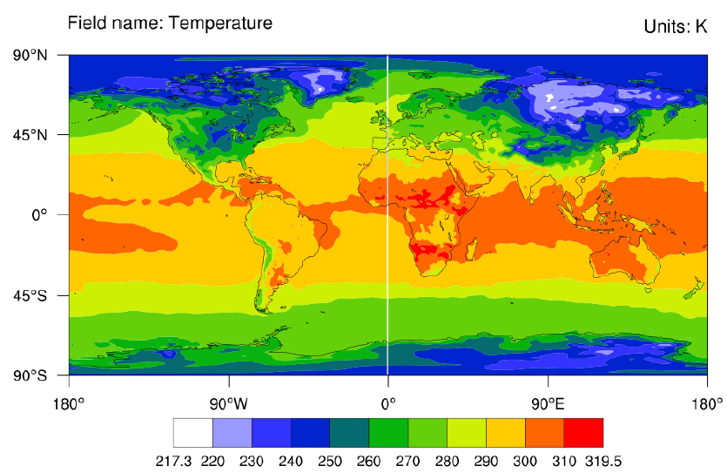
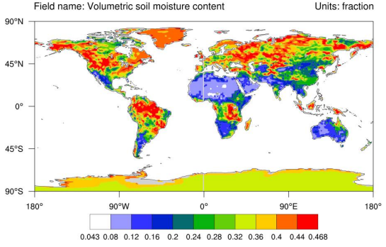

Slide 15
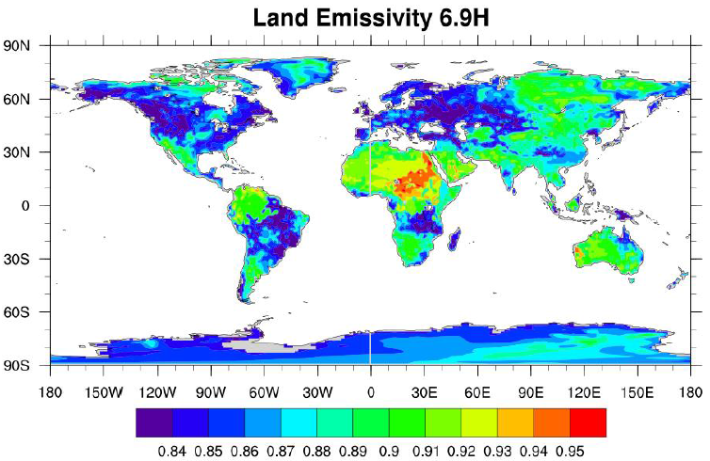
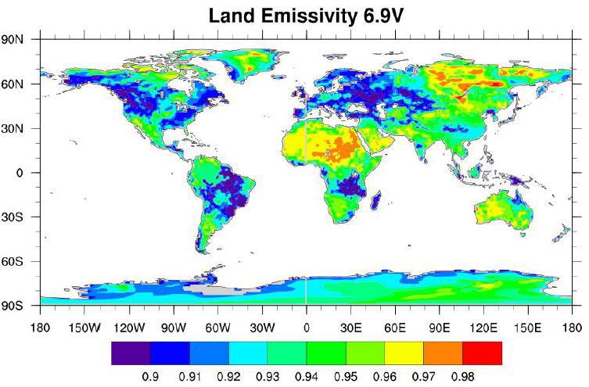
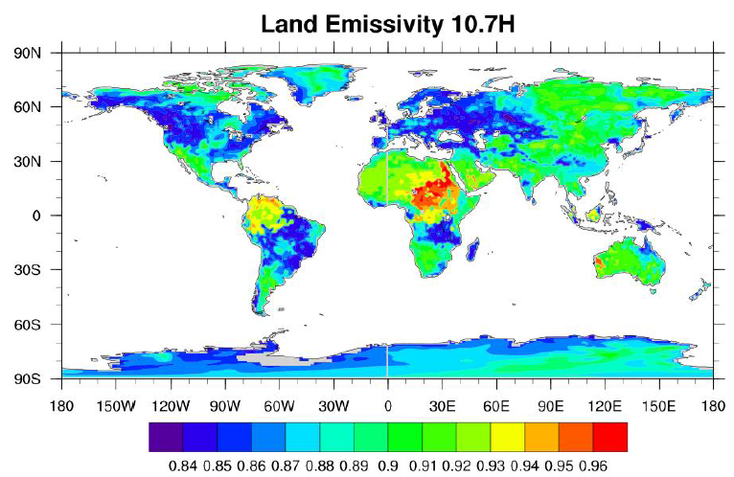
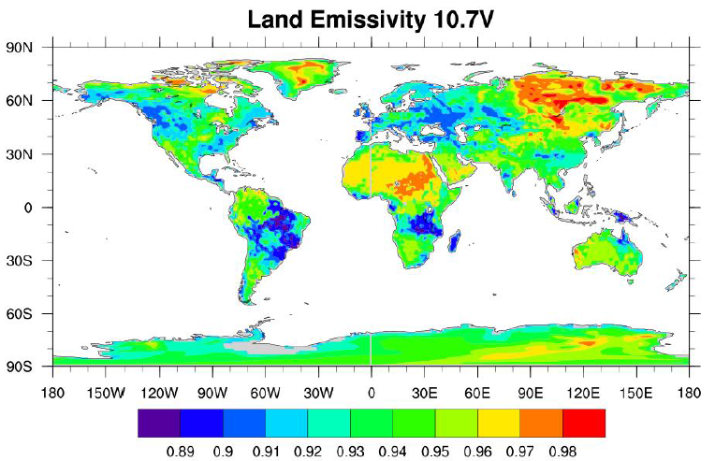
Global emissivity at 12:00 on January 1st ,2001
Emissivity is high in Siberia, Sahara, where the vegetation fraction and soil moisture are both small. In contract, the areas where vegetation fraction and soil moisture are high have low emissivity, like Amazon rainforest, African rainforest.

Slide 16
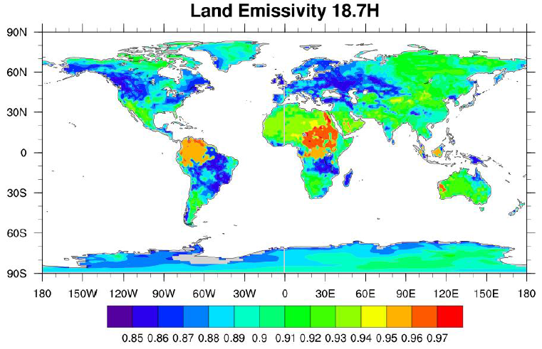
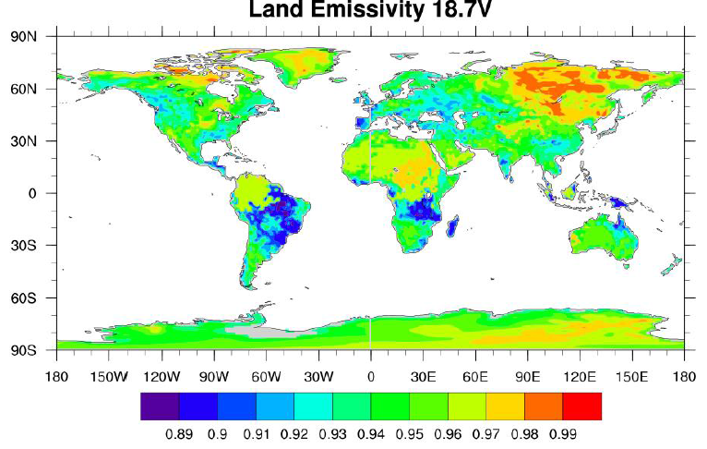
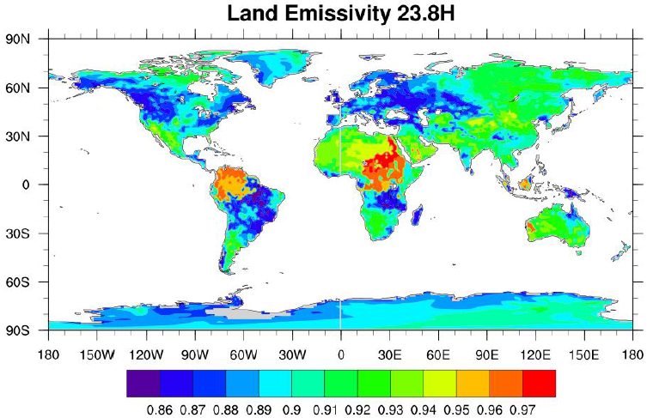
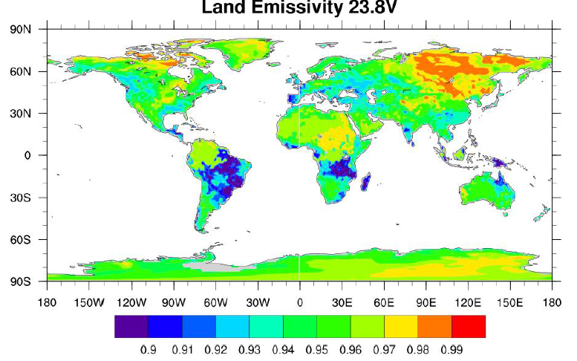
Kind of same to the channel of 6.9GHz and 10.7 GHz

Slide 17
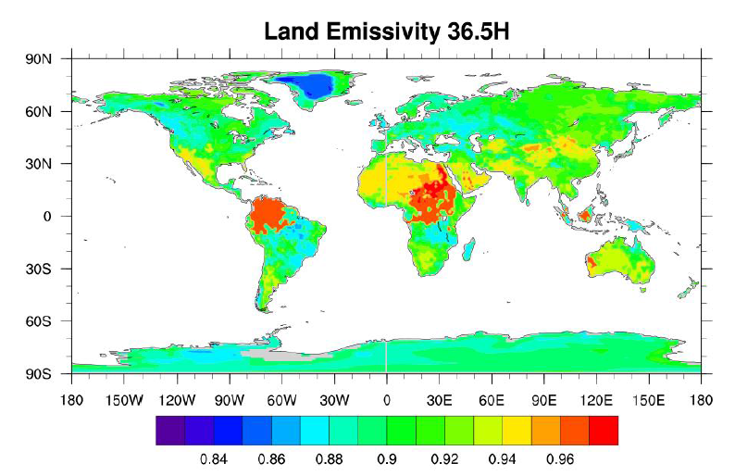
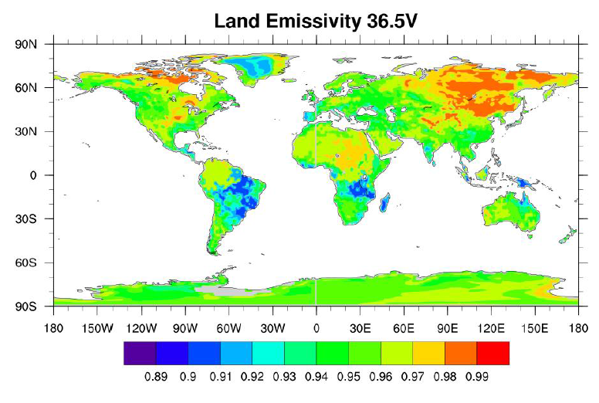
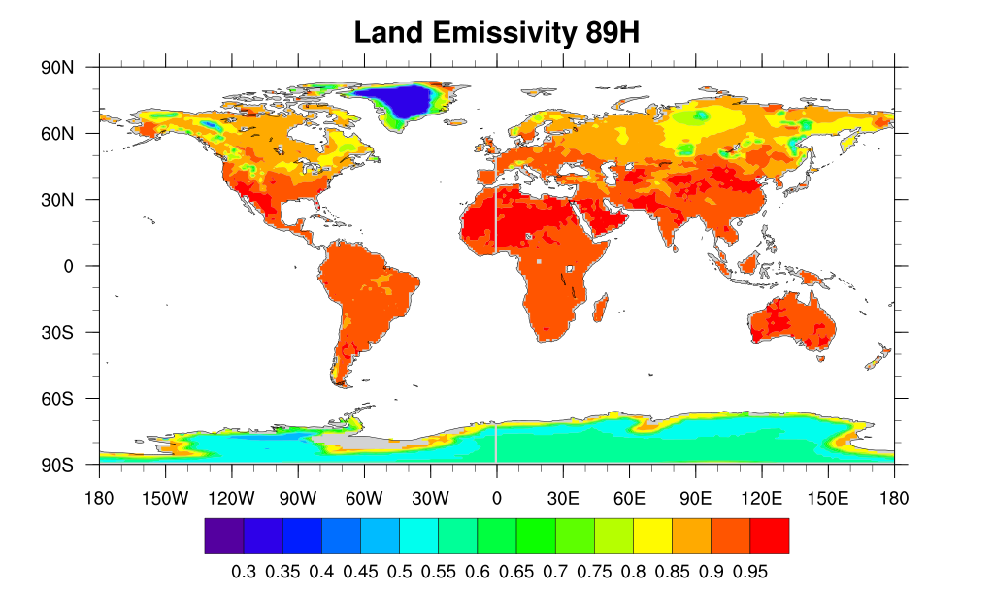
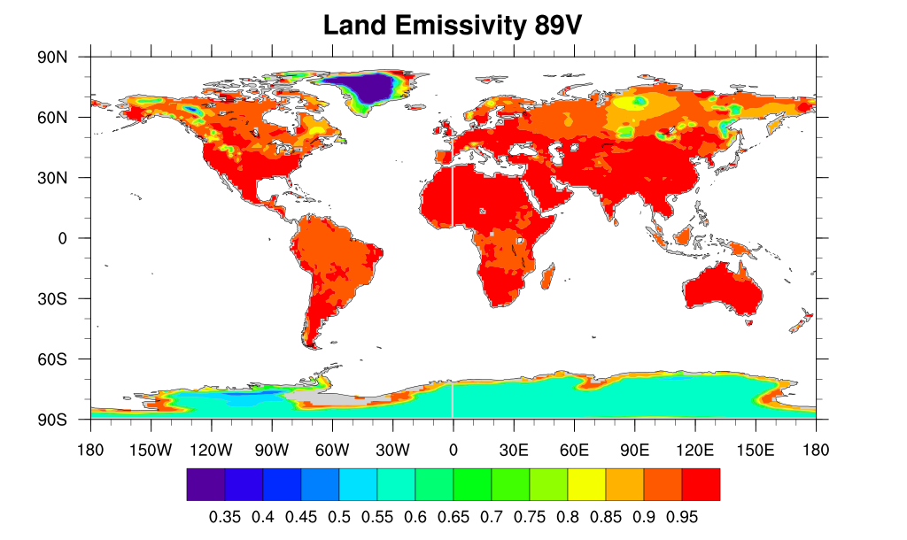
The 89GHz has a high emissivity over global areas, except the Greenland and Antarctica, where the snow depth is at high level.

Slide 18
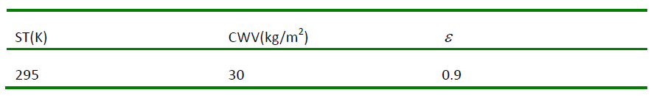
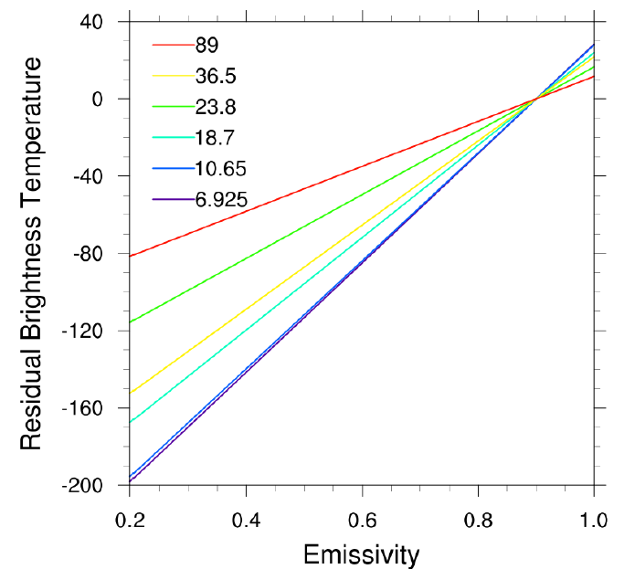
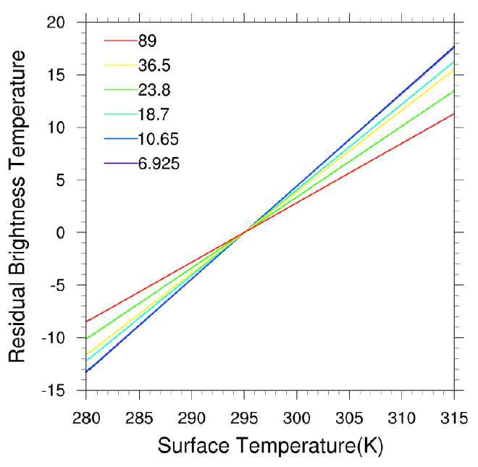
Simulation experiments (MWRT) - the response of brightness temperature to the environmental parameters in the atmosphere
The response of brightness temperature to the emissivity & surface temperature
The brightness temperature is linear proportional to the emissivity.
The channel of 6.923GHz and 10.65GHz are very sensitive to the emissivity.
The channel of 89GHz is the least sensitive channel.
Water vapor in the atmosphere- Water vapor has different abilities of emission and transmission in different channels.

Slide 19
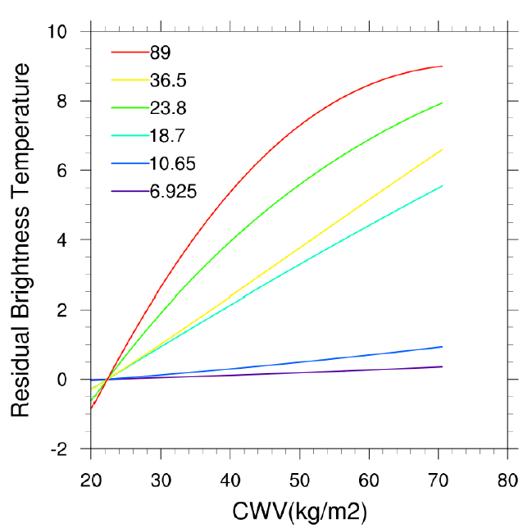
The response of brightness temperature to CWV
With the CWV increasing, brightness temperature increases, but it is not linear proportional to the CWV. The brightness temperature in 89GHz channel is most sensitive.
23.8 GHz is also sensitive. It is because the 23.8GHz channel is located near the water vapor absorbing band (22.235GHz and 183GHz).

Slide 20
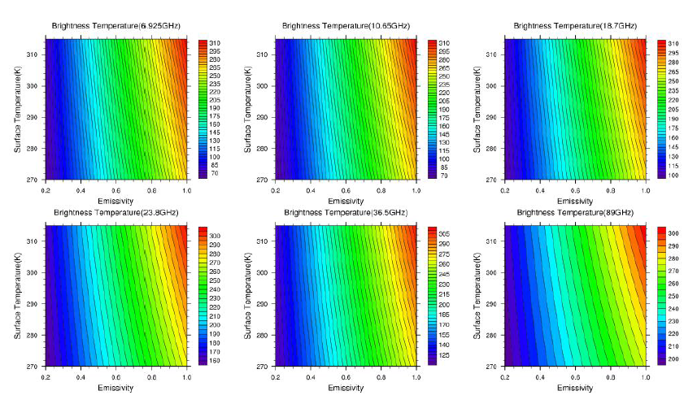
The response of brightness temperature to the emissivity and surface temperature
When we set different emissivity, the sensitivity of brightness temperature to the surface temperature will not change.
Also, when we set different surface temperature, the sensitivity of brightness temperature to the emissivity will not change.

Slide 21
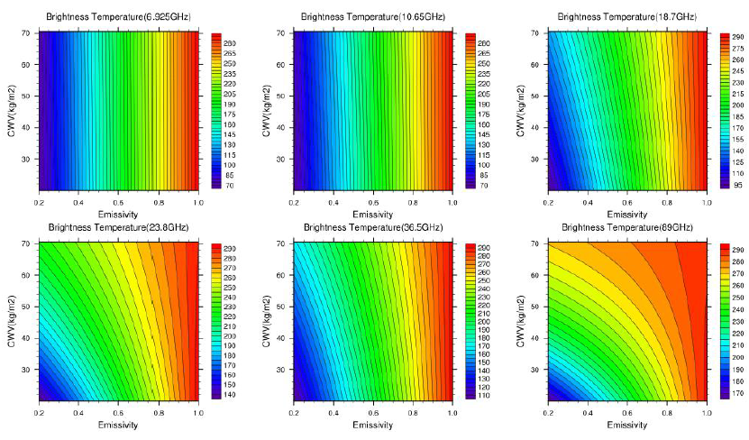
The response of brightness temperature to the emissivity and CWV
Since brightness temperature is not linear proportional to CWV, when the CWV is different, the sensitivity of the brightness temperature will be different to the emissivity.

Slide 22
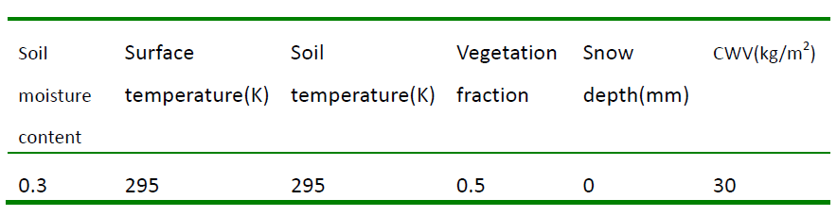
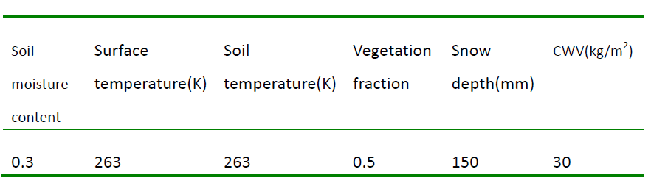
Simulation of the response of brightness temperature to the land properties after combination of CRTM and MWRT
Typical values for tropical area:
Typical values for boreal area:

Slide 23
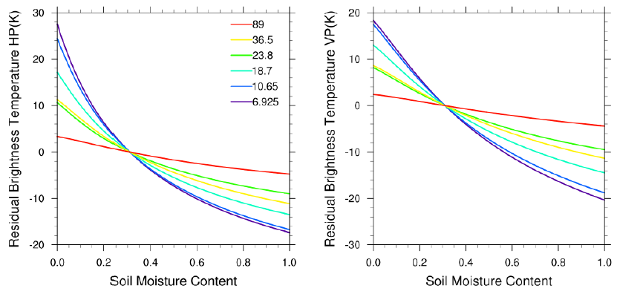
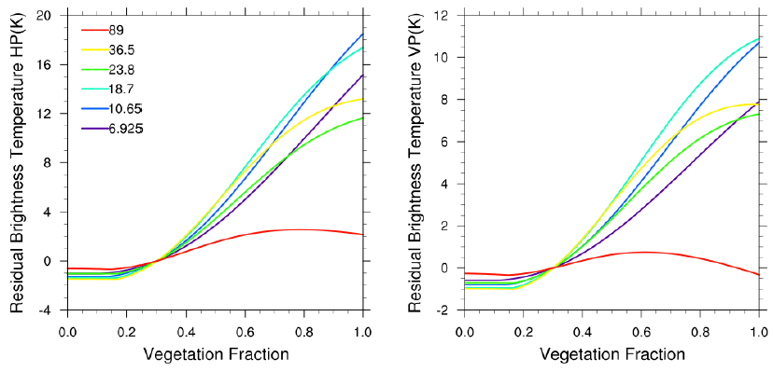
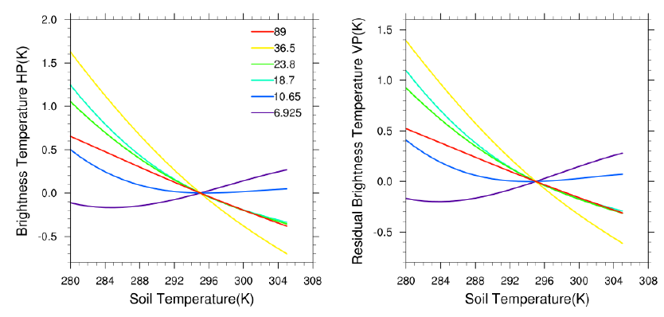
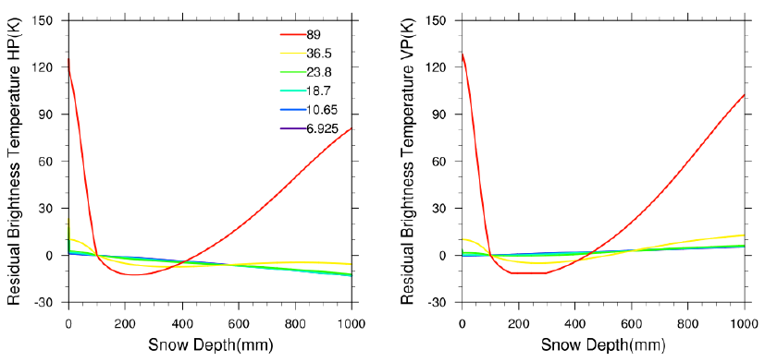
The brightness temperature is linear proportional to the change of the emissivity as said above. The result of the response of brightness temperature to the land properties is very similar to the response of emissivity to the change of land properties

Slide 24
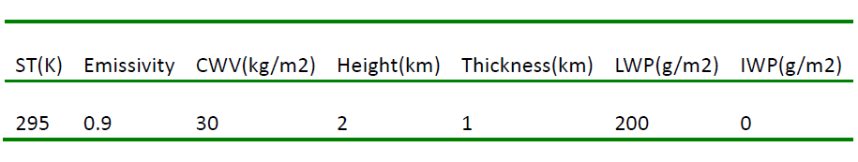
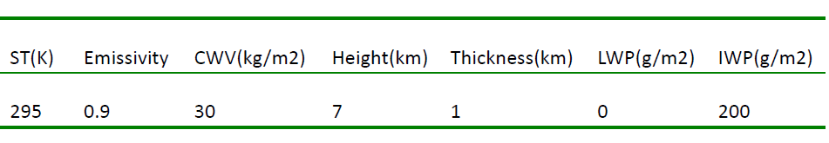
Simulation of the response of brightness temperature when the non-precipitation clouds exits
There are three types of clouds in the atmosphere: water cloud, ice cloud and mixed cloud.
Water cloud is called warm cloud, it contains liquid water. The signal is mainly from the surface signal plus the water signal.
Ice cloud contains only ice form of water, thus the liquid water path is 0.
Water Cloud:
Ice Cloud:

Slide 25
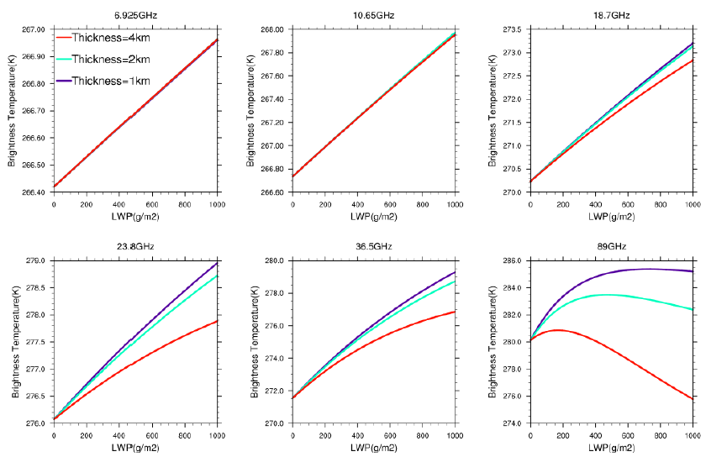
The response of brightness temperature to LWP in different thickness of water cloud
For 89GHz, the brightness temperature increases and then decreases.
When I set the thickness 1km, 2km and 4km, the brightness temperature in low frequencies will not be affected.

Slide 26
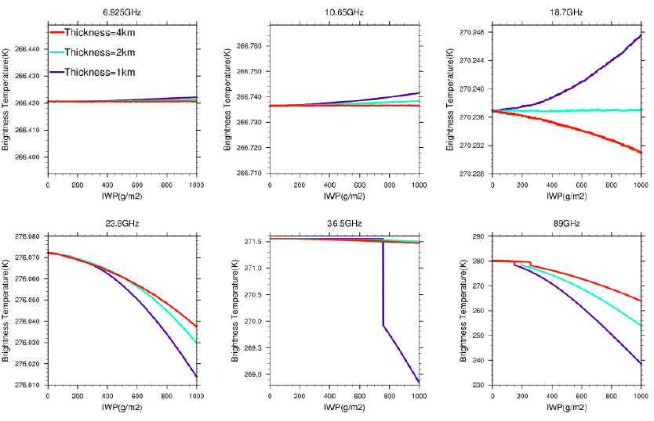
The response of brightness temperature to IWP in different thickness of water cloud
These results seem to be wrong, and I don’t know the reason now.
But we can still notice that 6.925GHz amd 10.65GHz are not affected by the IWP nor the thickness.

Slide 27

The response of brightness temperature to emissivity in different LWP
The more water cloud there is, the less sensitive the brightness temperature will become.
LWP has little effect on the low frequencies. Which means that microwave in low frequencies has better penetration through the water cloud.

Slide 28

The response of brightness temperature to emissivity in different IWP
Nearly the same to LWP results.
Only the 89GHz has been affected by IWP. In this channel, the more IWP it has, the higher brightness temperature is.

Slide 29
Summary
Use CRTM to study responses to different land surface properties emissivity (like soil moisture, soil temperature, vegetation fraction and snow depth).
Input the NCEP FNL and MODIS data to CRTM, and get the results about global emissivity distribution of different channels.
Use MWRT to study environment properties influence on transmission of the microwave radiation in the clear sky (emissivity, surface temperature and CWV).
Combine the CRTM and MWRT to study the sensitivity of different land surface properties to brightness temperature.
Study the non-precipitation cloud impact on the transmission of the radiation (IWP,LWP).
Since we can’t find the exact global atmosphere profile to input the MWRT, we don’t simulate the global brightness temperature in this study. These results are only the element study of the retrieval. If we need a more accurate and comprehensive result, a deeper understanding of the physics mechanism and a more specific retrieval model are necessary.

